Slide 1

Trackify: AI-Powered Task Management System
Submitted by:
Muhammad Abdullah Qureshi (BSSE23101-B)
Shuja Ud Din (BSSE23035-B)

Slide 2

Executive Summary: Trackify's Vision
Traditional task management tools often lack predictive insights and workflow optimization, leading to significant time spent on manual updates and reactive issue management.
Trackify addresses these challenges by integrating AI-driven automation with a cloud-native AWS microservices architecture. It provides predictive task suggestions, automated planning, risk anticipation, and optimized workflows.
Deployed on AWS EC2 with load balancing and auto-scaling, Trackify ensures high availability and performance. IAM roles secure access, credentials are in AWS Secrets Manager, and VPC peering enables secure connectivity. Task data is managed using MongoDB Atlas for scalable storage.

Slide 3

Introduction & Problem Statement
Introduction
Problem Statement
Efficient project management is crucial, but traditional tools often lack intelligence and automation. Teams struggle with manual updates, poor workflow optimization, and limited risk anticipation.
Existing task management systems:
Rely heavily on manual updates, causing inefficiencies.
Lack predictive insights for proactive planning.
Fail to optimize workflows, leading to wasted time and resources.
Trackify leverages AI and AWS cloud services to overcome these limitations, offering automated task planning, predictive insights, and secure cloud deployment to enhance team efficiency.
There is a clear need for a smart, cloud-based system that automates planning, predicts risks, and improves productivity.

Slide 4



Aim & Objectives
1
2
3
Aim
AI Engine Development
Scalable AWS Deployment
To develop an AI-driven, cloud-native task management system that automates workflows, predicts risks, and enhances team productivity.
Develop an AI engine for predictive task suggestions and risk anticipation.
Deploy on AWS EC2 with load balancing and auto-scaling for scalability.
4
5
Security & Data Management
User-Friendly Frontend
Secure with IAM roles, AWS Secrets Manager, and MongoDB Atlas for efficient data storage.
Provide a responsive, user-friendly frontend for task visualization and management.

Slide 5
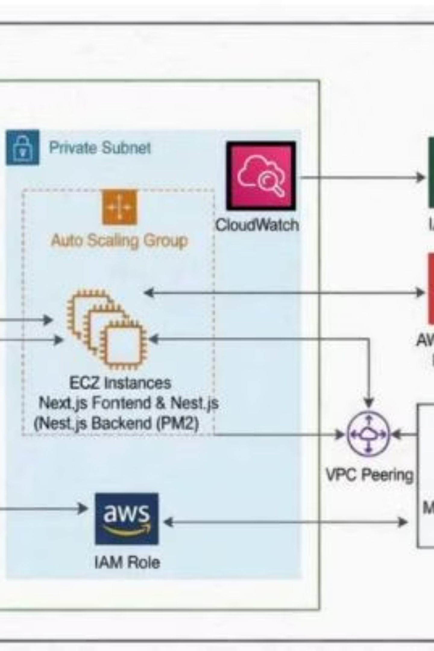
Architectural Diagram
The Trackify architecture is designed for high availability and security within AWS. It utilizes a VPC with public and private subnets, an Application Load Balancer (ALB), Auto Scaling Group with EC2 instances, and secure connections to AWS Secrets Manager and MongoDB Atlas via VPC Peering.

Slide 6
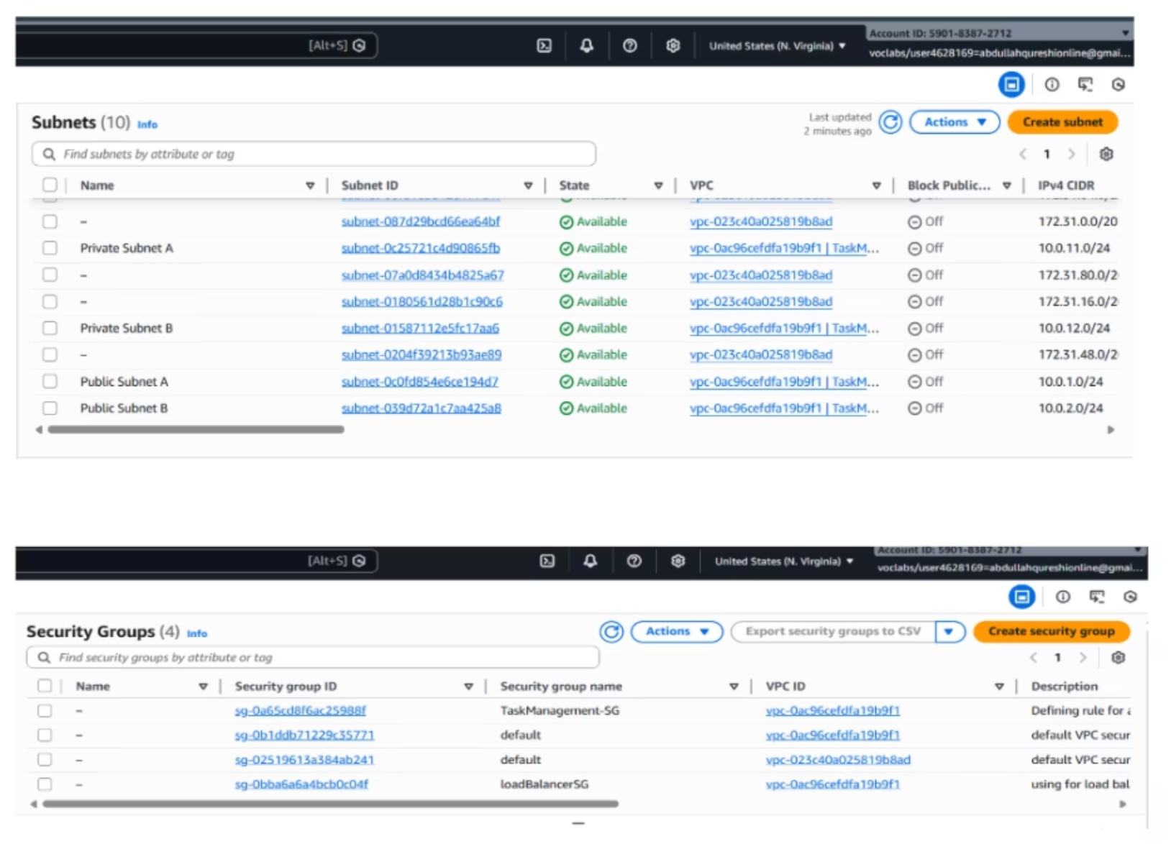
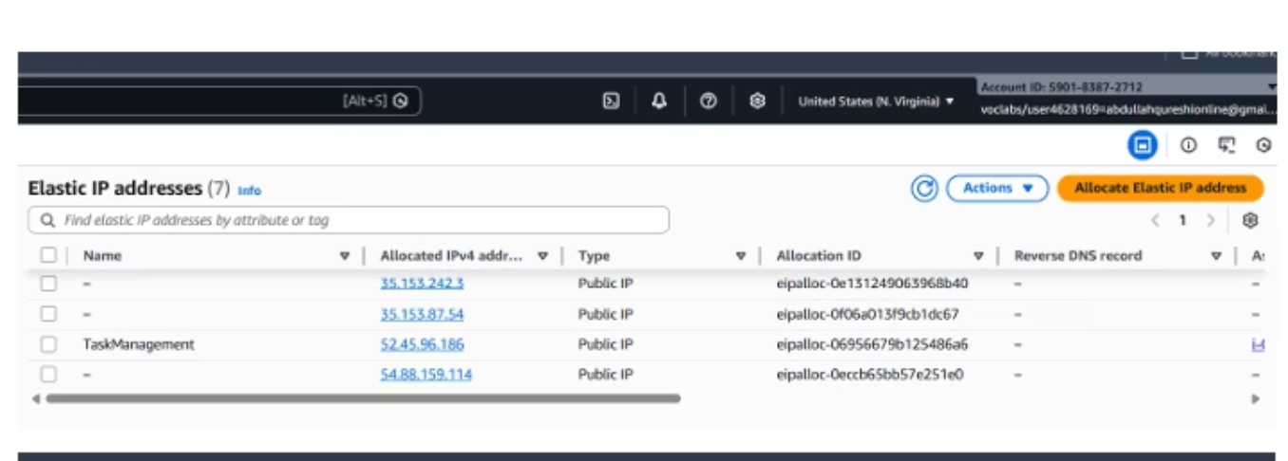
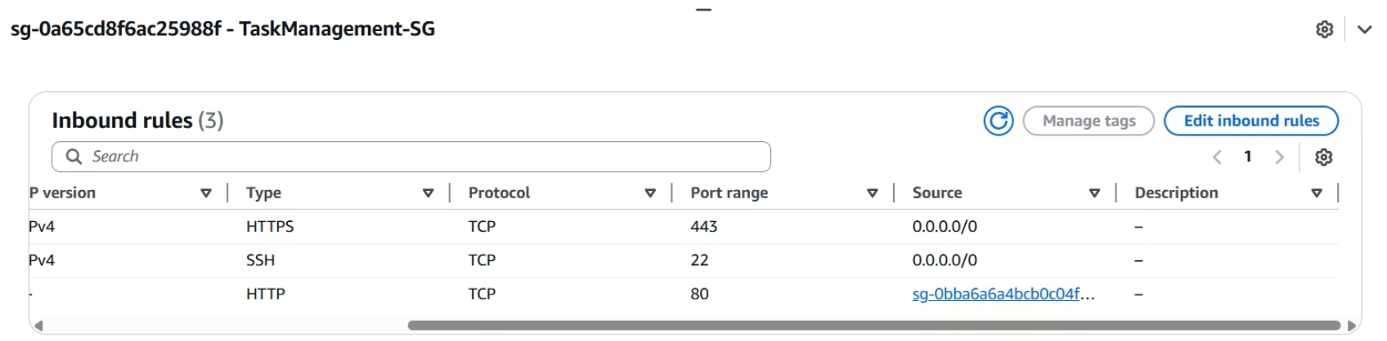
AWS Foundation Architecture
Virtual Private Cloud (VPC)
Elastic IP & Security Group
Our AWS foundation begins with a Virtual Private Cloud (VPC), providing an isolated network environment for Trackify. This allows for granular control over network configuration, including IP address ranges(, subnets, route tables, and network gateways.
Elastic IP addresses provide static public IPv4 addresses for our instances, ensuring consistent access. The TaskManagement-SG secures your instances by allowing public access via HTTPS (443) and SSH (22). Importantly, it restricts HTTP (80) traffic solely to your Load Balancer, preventing direct public exposure and ensuring all traffic is filtered through your architecture.

Slide 7
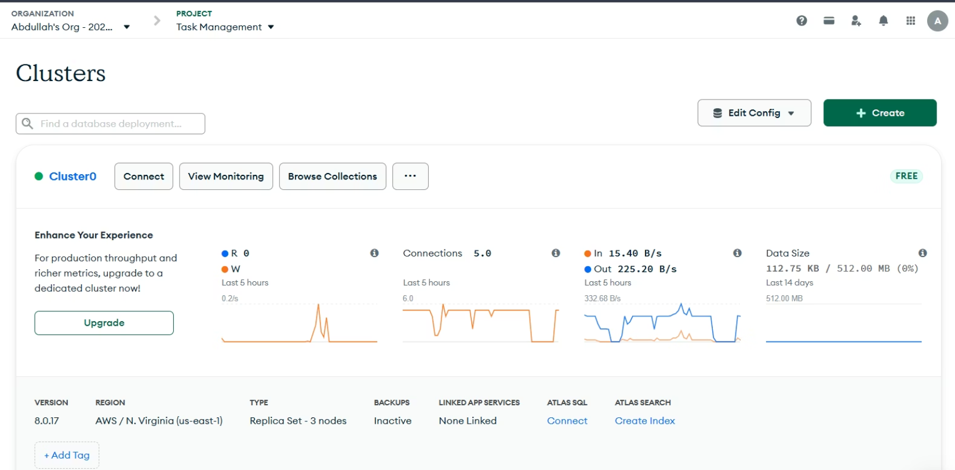
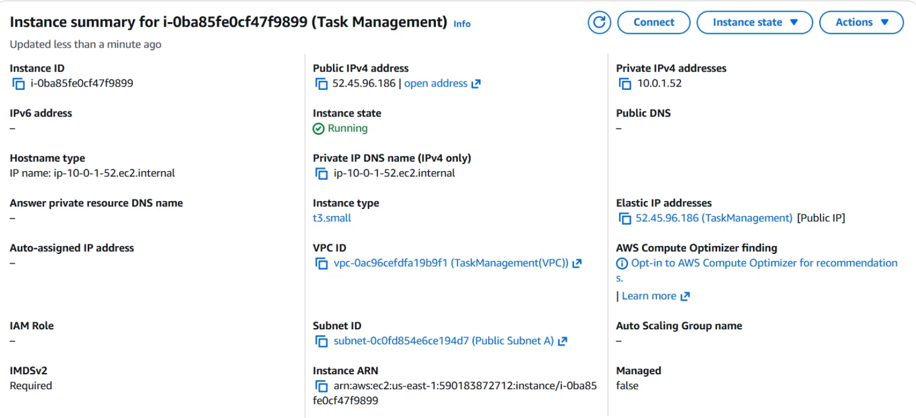
MongoDB Atlas & EC2 Deployment
MongoDB Atlas Cluster
EC2 Instances & Launch Templates
Trackify leverages MongoDB Atlas for scalable and reliable task data storage. The cluster is configured for high availability and performance, with VPC peering ensuring secure network connectivity between our AWS environment and the MongoDB Atlas database.
Our application runs on AWS EC2 instances, managed by Auto Scaling Groups. Launch templates define the configuration for these instances, including the AMI, instance type (t3.small), and security groups, ensuring consistent and automated deployment.

Slide 8

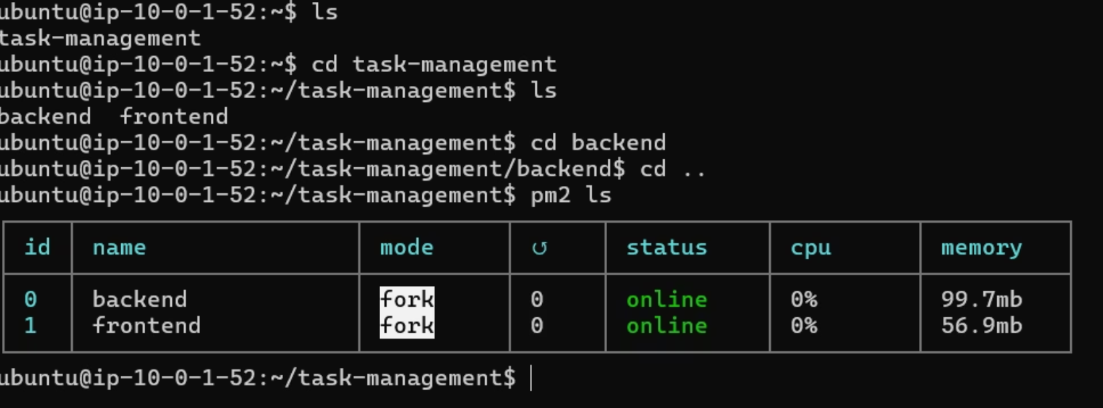
Domain, SSL & Testing
Domain & SSL Configuration
Application Testing & Logs
The Trackify application is accessible via a custom domain, programpeer.com. AWS Certificate Manager (ACM) provides and manages SSL certificates, ensuring secure HTTPS communication and encrypting data in transit.
Rigorous testing confirms the proper functioning of both frontend and backend components. PM2 process manager ensures continuous operation, and detailed logs provide insights into application behavior and route mapping for debugging and monitoring.

Slide 9
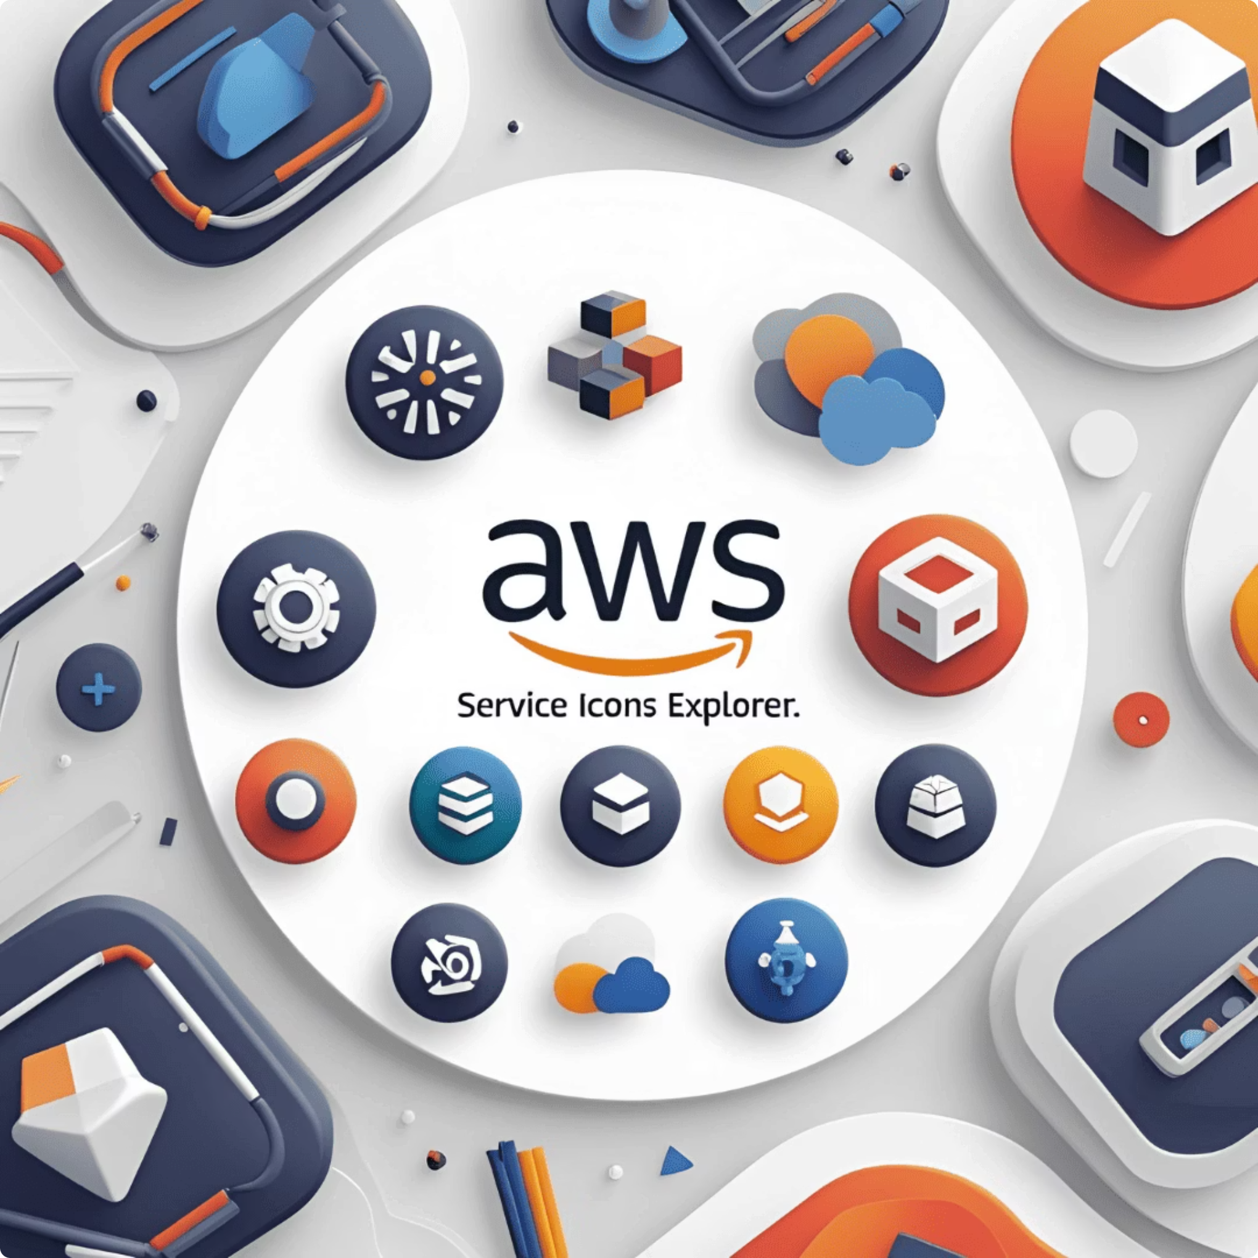




Load Balancer & Auto Scaling
Application Load Balancer (ALB)
Target Groups
Target groups route requests to registered targets (EC2 instances). Our configuration shows 2 healthy targets, ensuring that traffic is only sent to operational instances.
The ALB distributes incoming application traffic across multiple targets, such as EC2 instances, in multiple Availability Zones. This increases the fault tolerance of the application and ensures high availability.
Auto Scaling Group
The Auto Scaling Group dynamically adjusts the number of EC2 instances based on demand. With a desired capacity of 1 and scaling limits of 1-3, Trackify can automatically scale to maintain performance and cost efficiency.

Slide 10


